Slide 1
Skin Lesion Classification Using Deep Learning
Neural Network Out!
Lihao Wang (z5474242)
Haosheng Ren (z5484476)
Chaorong Lei (z5405778)
Xuefei He (z5504912)
Zelong Hu (z5507000)

Slide 2
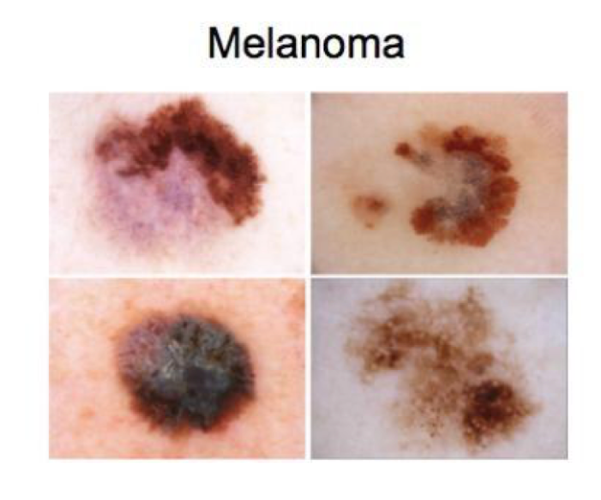
Motivation
Melanoma is one of the deadliest types of skin cancer.
Defects on or under the skin are collectively known as skin lesions.
Benign skin tumors and Malignant tumors.
Difficult to automatically identify malignant tumors from dermoscopic images.[2]
We want to do a successful deep learning strategy which can identify dermoscopic lesions.
Figure1: example images of ISIC dataset [1]
[1] COMP9444: Neural Networks and Deep Learning Project Description List, Page 2
[2] Samia Benyahia, Boudjelal Meftah, Olivier Lezoray, “Multi-features extraction based on deep learning for skin lesion classification”, Tissue and Cell, www.elsevier.com/locate.tice
Presenter: Lihao Wang (z5474242)

Slide 3
Problem Statement
Complexity of Skin Lesions
Limitations of Traditional Methods
Advancements in Deep Learning
Study Objective
Ultimate Goal
Presenter: Haosheng Ren (z5484476)

Slide 4
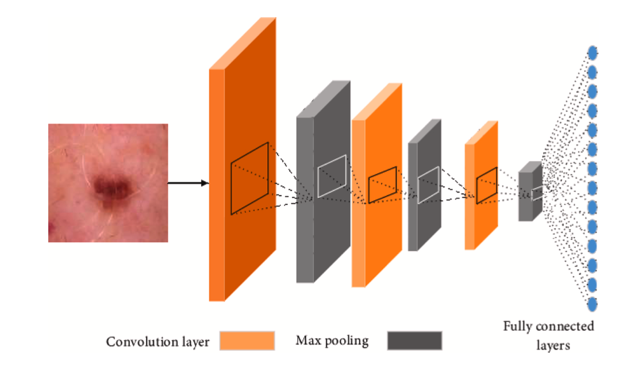
Literature Review
Multi-features extraction based on deep learning for skin lesion classification [1]
Skin lesion classification from dermoscopic images using deep learning techniques [2]
Figure 2: Feature extraction with CNN [1]
[1] Samia Benyahia, Boudjelal Meftah, Olivier Lezoray, “Multi-features extraction based on deep learning for skin lesion classification”, Tissue and Cell, www.elsevier.com/locate.tice
[2] Adria Romero Lopez, Xavier Giro-i-Nieto, Jack Burdick, Oge Marques “Skin lesion classification from dermoscopic images using deep learning techniques”, Proceedings of the IASTED International Conference, Biomedical Engineering (BioMed2017)
Presenter: Chaorong Lei (z5405778)

Slide 5

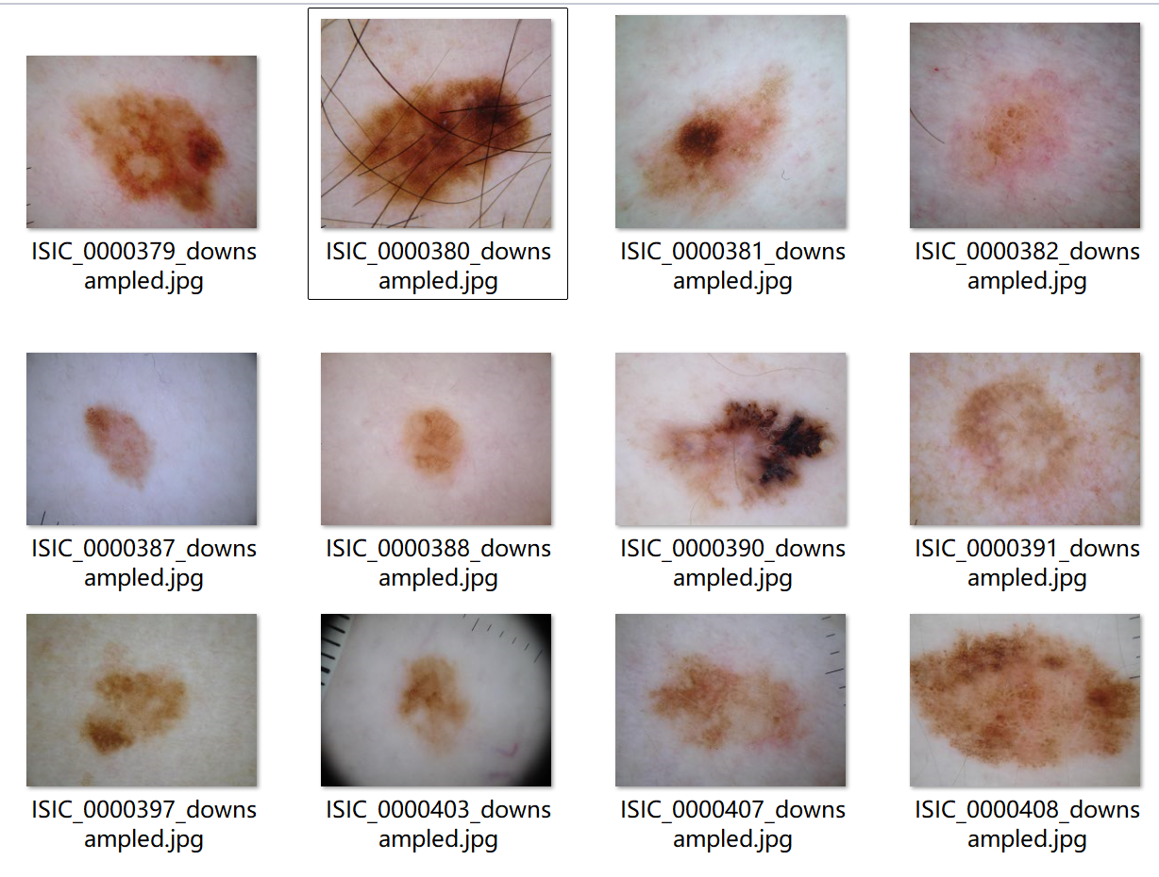
Dataset
From ISIC (International Skin Imaging Collaboration​)
8 skin disease categories
Large dataset with over 20,000 images
Available in JPG format
Contains accompanying CSV file with labels
Figure 3: Data Images [1]
[1] https://challenge.isic-archive.com/data/#2019
Presenter: Xuefei He (z5504912)

Slide 6
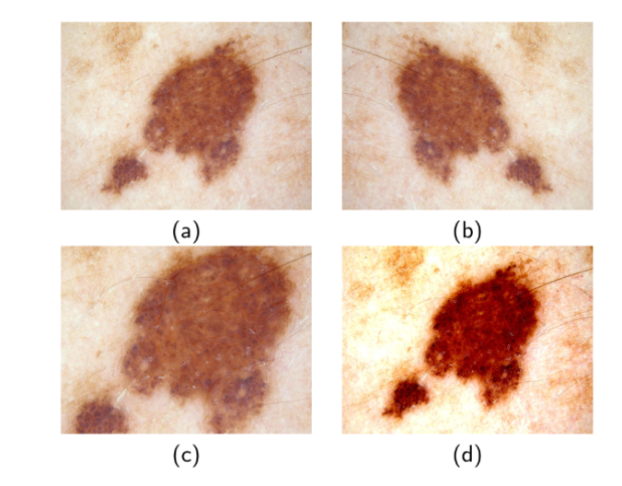
Data Analysis
For data analysis and preprocessing, we focused on balancing the dataset and preparing it for training.
Data Split: We split the data into training, validation, and test sets with ratios of 60%, 20%, and 20% respectively.
Data Balance: To balance the training data, we implemented data augmentation and under-sampling.
Transformations: We applied some common transformations, such as resizing the images to 224*224 pixels, converting the images to tensor format, and normalization.
Figure 4: Data Augmentation [1]
Original image
After flipping
After cropping
After changing its contrast
[1] Samia Benyahia, Boudjelal Meftah, Olivier Lezoray, “Multi-features extraction based on deep learning for skin lesion classification”, Tissue and Cell, www.elsevier.com/locate.tice
Presenter: Xuefei He (z5504912)

Slide 7
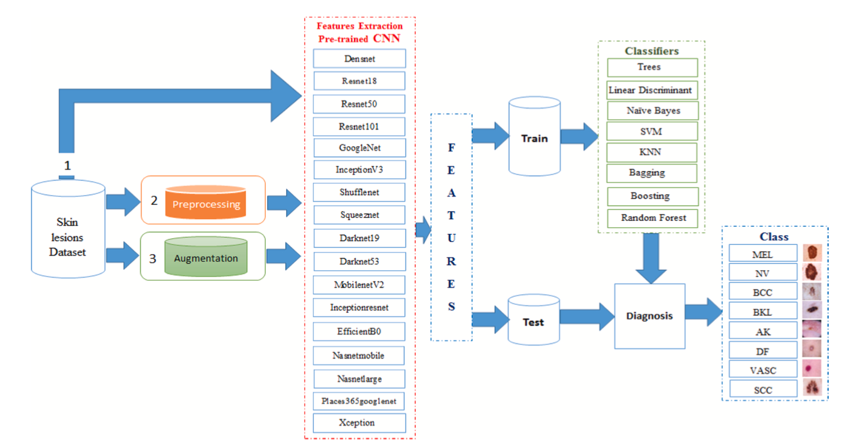
Method
Feature Extraction (Transfer Learning)
To extract features, we get rid of the last layer which is the fully connected layer from the pre-trained architecture and use the other parts. The following CNN architectures are used in this project.
VGG
ResNet 50
ResNet 101
DenseNet 201
Classification
Fully Connected Layer
Cubic SVM
Figure 5: Proposed method flowchart [1]
[1] Samia Benyahia, Boudjelal Meftah, Olivier Lezoray, “Multi-features extraction based on deep learning for skin lesion classification”, Tissue and Cell, www.elsevier.com/locate.tice
Presenter: Haosheng Ren (z5484476)

Slide 8
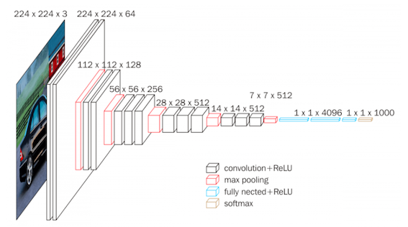
Method - Feature Extraction
VGG
Network Overview
Architecture
Convolutional Layers
Fully Connected Layers
Softmax Activation
How It Works for Skin Lesion Classification
Input Preprocessing
Feature Extraction
Transfer Learning
Classification
Figure 6: VGG Architecture Diagram
Presenter: Haosheng Ren (z5484476)

Slide 9
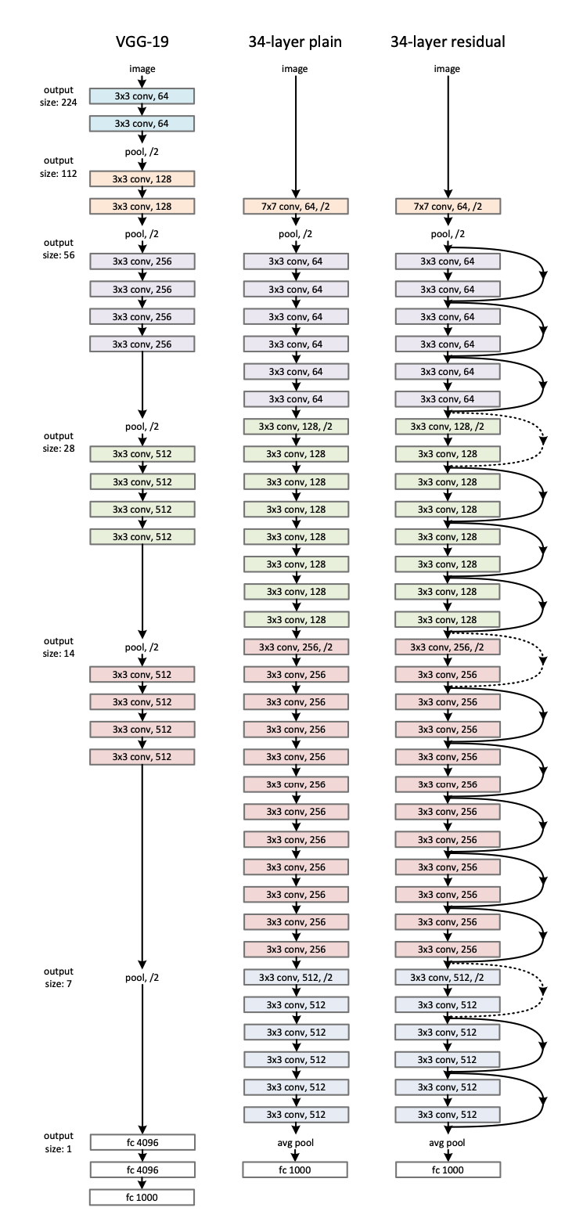
Method - Feature Extraction
ResNet50
ResNet is an advanced version of CNN. The main focus is using residual blocks
Each 2-layer block in the 34-layer net was replaced with 3-layer bottleneck block, resulting in a 50-layer Resnet. [2]
Bottleneck architecture: three layers 1 x 1 convolution layer, 3 x 3 convolution layer and another 1 x 1 convolution layer.
Figure 7: Example network architectures for ImageNett [3]
[2] Kaiming He, Xiangyu Zhang, Shaoqing Ren, Jian Sun, “Deep Residual Learning for Image Recognition”, CVPR 2016, Page 775
[3] Kaiming He, Xiangyu Zhang, Shaoqing Ren, Jian Sun, “Deep Residual Learning for Image Recognition”, CVPR 2016, Page 773
Presenter: Chaorong Lei (z5405778)

Slide 10
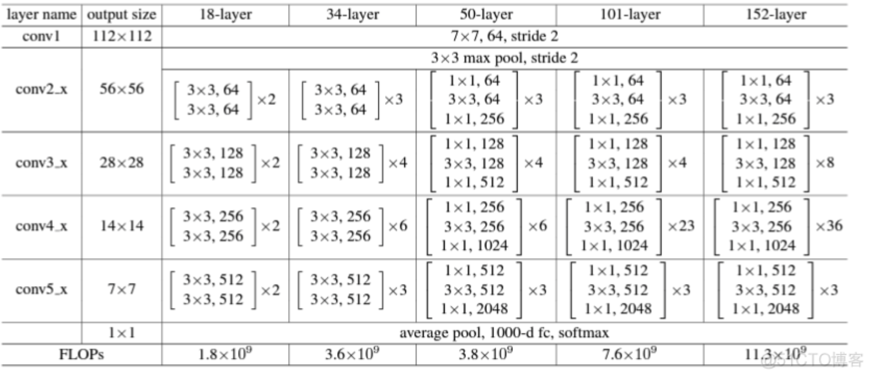
Method - Feature Extraction
Resnet-101
ResNet-101 has more layers, it performs better than resnet50 in handling tasks.
Figure 8: ResNet model comparison [1]
[1] https://blog.51cto.com/u_14850/11122295
Presenter: Lihao Wang (z5474242)

Slide 11
Method - Feature Extraction
Resnet-101
ResNet-101 has more layers, it performs better than resnet50 in handling tasks.
3*6=18
3*23=69
69-18=51
101-50=51
[1] https://blog.51cto.com/u_14850/11122295
Figure 9: ResNet model comparison [1]
Presenter: Lihao Wang (z5474242)

Slide 12
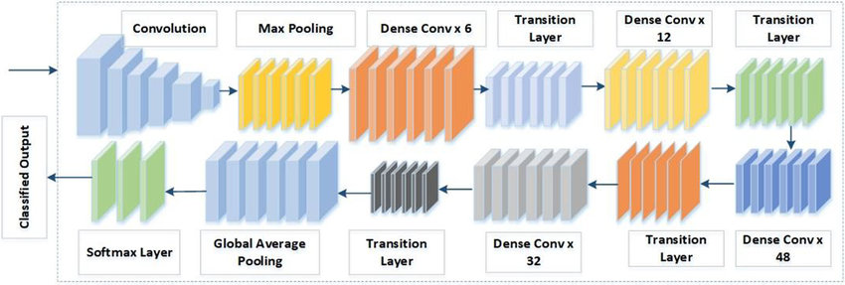
Method - Feature Extraction
DenseNet-201
Architecture & Features
201-layer deep network
Dense connectivity pattern
Feature reuse
Efficient use of parameters
Figure 8: Detailed Architecture of an Efficient DenseNet-201 [1]
https://www.researchgate.net/figure/Detailed-architecture-of-an-Efficient-DenseNet-201_fig3_360070131
Presenter: Zelong Hu (z5507000)

Slide 13
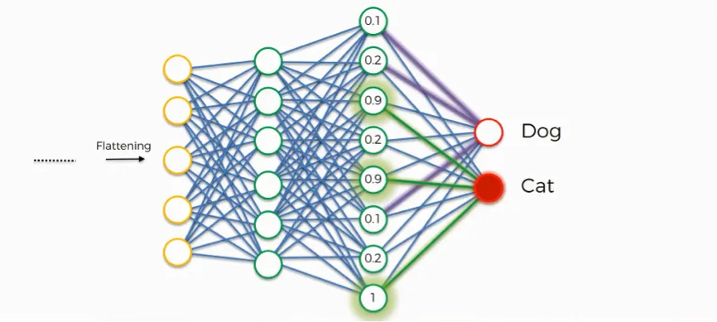
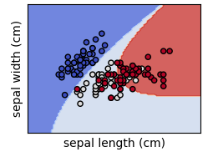
Method - Classification
Fully Connected Layer
End-to-end learning
Custom layers add
Feature extraction + SVM method
Fixed feature extraction
SVM classification
Performance Comparison
Fine-tuning method performs better
Possible reasons:
End-to-end learning
Task-specific feature capture
Better at modeling complex relationships
Figure 5: Fully connected layer
Figure 6: SVC with polynomial (degree 3) kernel [2]
[1] https://medium.com/@rajat.k.91/convolutional-neural-networks-why-what-and-how-f8f6dbebb2f9
[2] https://scikit-learn.org/stable/modules/svm.html
Presenter: Zelong Hu (z5507000)

Slide 14
Results
Original Data | VGG16 | VGG16 + Cubic SVM | ResNet50 | ResNet50 + Cubic SVM | ResNet101 | ResNet101 + Cubic SVM | DenseNet201 | DenseNet201 + Cubic SVM
F1 | 0.6533 | 0.3553 | 0.6918 | 0.6911 | 0.7524 | 0.6812 | 0.7475 | 0.3352
IoU | 0.3414 | 0.0700 | 0.5518 | 0.3113 | 0.4563 | 0.5432 | 0.4436 | 0.2307
AUC | 0.8903 | 0.6739 | 0.8969 | 0.8712 | 0.9317 | 0.8762 | 0.8783 | 0.8948
Accuracy | 64.24% | 51.04% | 69.77% | 71.98% | 93.92% | 71.03% | 74.71% | 63.82%
Processed Data | VGG16 | VGG16 + Cubic SVM | ResNet50 | ResNet50 + Cubic SVM | ResNet101 | ResNet101 + Cubic SVM | DenseNet201 | DenseNet201 + Cubic SVM
F1 | 0.6277 | 0.4127 | 0.7808 | 0.7104 | 0.7844 | 0.6973 | 0.7311 | 0.3491
IoU | 0.3038 | 0.0825 | 0.6560 | 0.3696 | 0.5790 | 0.5589 | 0.4858 | 0.2409
AUC | 0.8700 | 0.7104 | 0.9413 | 0.8747 | 0.9487 | 0.8758 | 0.8806 | 0.8958
Accuracy | 64.28% | 55.32% | 78.92% | 72.25% | 94.70% | 70.71% | 73.01% | 64.80%
Presenter: Chaorong Lei (z5405778)

Slide 15
Discussion & Conclusion
Data Process
Original data used as base line
Processed data improved the performance
Model
VGG: Simple architecture
ResNet 50: Good for deeper networks
ResNet 101: Deeper than ResNet50, Best Performance
DenseNet 201: Ensure maximum information flow between layers.
Classification Methods
Fully connected layer: Perform well.
Cubic SVM: Better for small sample.
Best Result: ResNet 101 + Fully Connected Layer
Presenter: Chaorong Lei (z5405778)

Slide 16

Thank You!
This Photo by Unknown Author is licensed under CC BY-SA

